Slide 1
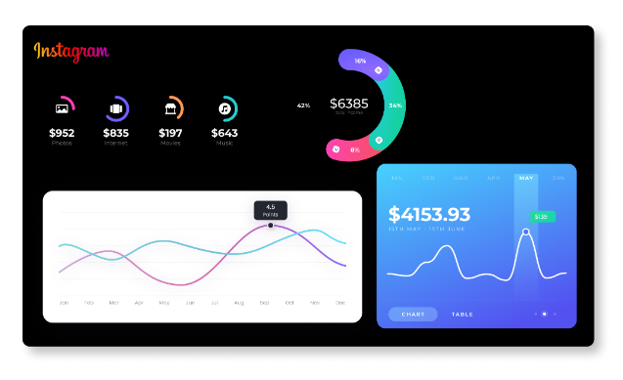
Instagram User Analytics
By- Shweta Kushwaha

Slide 2
PROJECT DESCRIPTION
This project will provide an insight of user interactions and engagement with the Instagram app which will help the product manager and the rest of the team make informed decisions about the future direction of the app. The marketing team will get an insights of launching a new campaign, the product team will get to know new features which are essential to build, and the development team will understand the overall user experience. This will help in the future development of one of the world's most popular social media platforms.

Slide 3
Approach
Created a database from provided dataset which will help in analyzing an old data.
After creating a database, analyzed the database tables for SQL queries.
By collecting all points which team needs to know for better performance of Instagram app ran the DDL and DML SQL queries.

Slide 4
Tech-Stack Used
Used MySQL Community Server 8.0.33 for creating this project. It’s the official graphical user interface(GUI) tool for MySQL. It allows you to design, create and browse your database schemas, work with database objects and insert data. It provide an open source platform to their users.

Slide 5
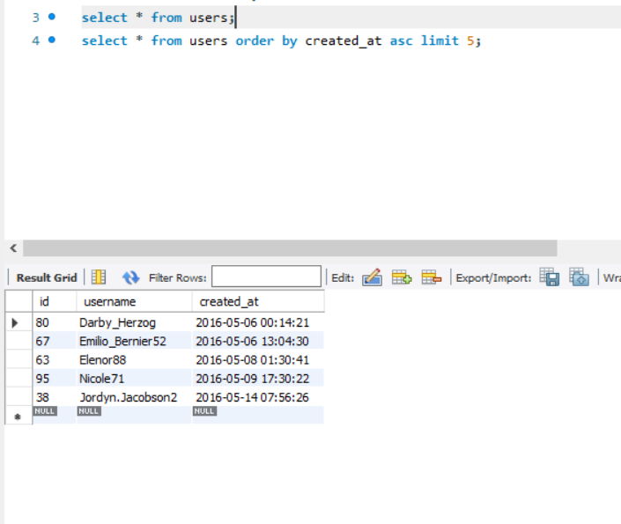
Q1. Identifying the five oldest users on Instagram from the provided database.
INSIGHTS: MARKETING

Slide 6
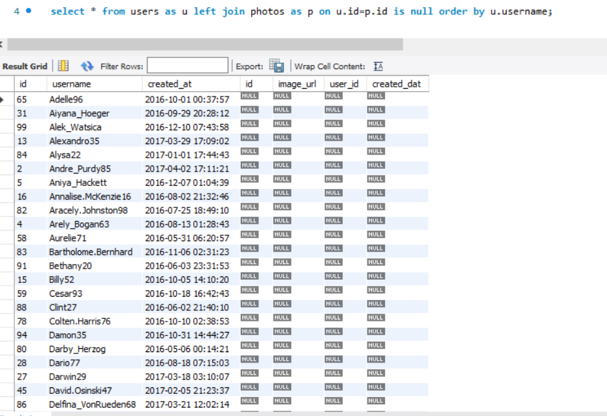
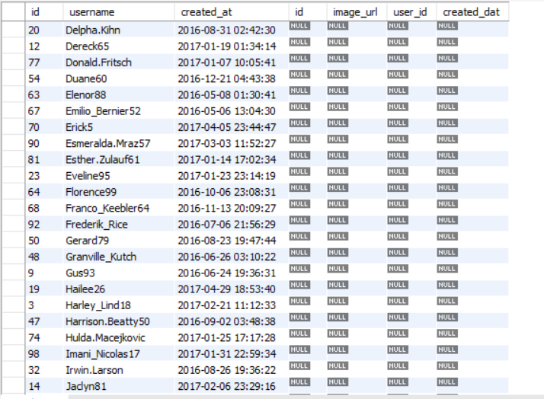
Q2. Identify users who have never posted a single photo on Instagram.
Contd..

Slide 7
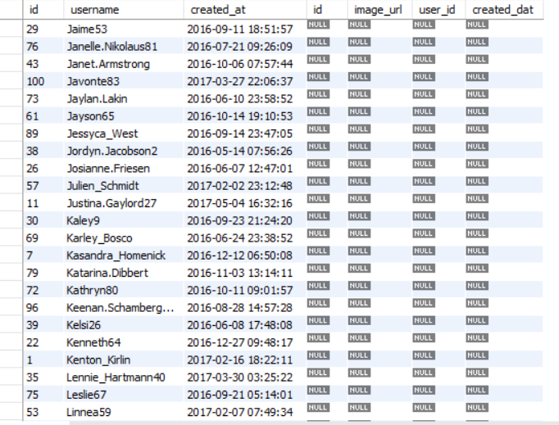
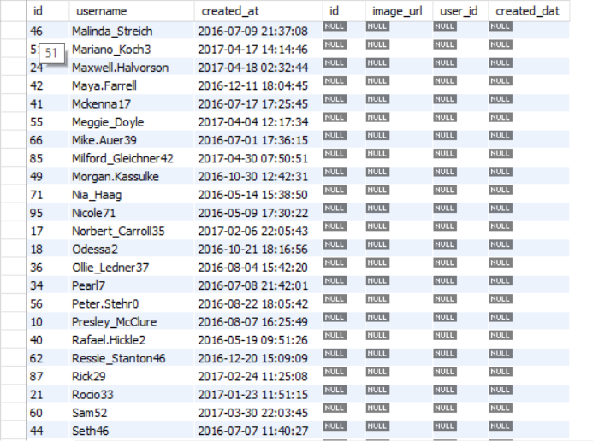
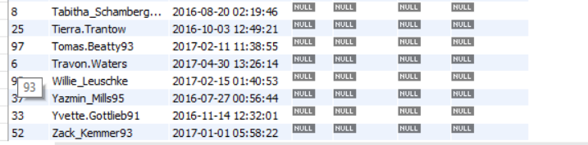
Q2. Identify users who have never posted a single photo on Instagram.
.

Slide 8
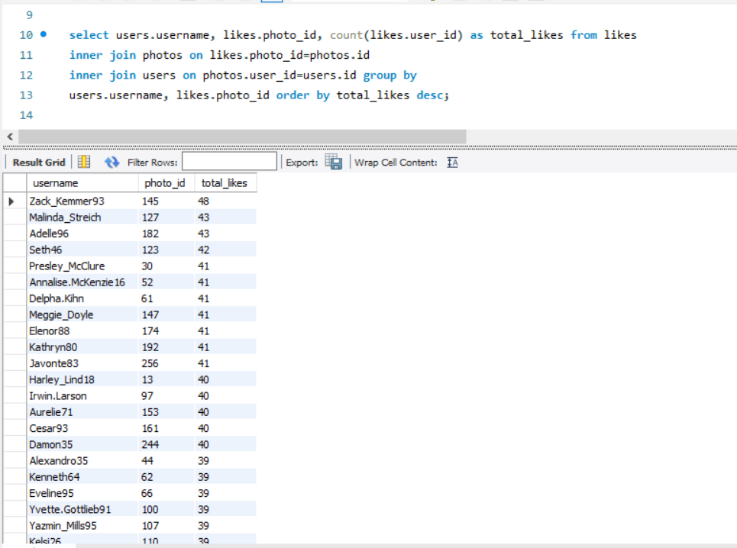
Q3. Determining the winner of the contest and provide their details to the team.
.

Slide 9
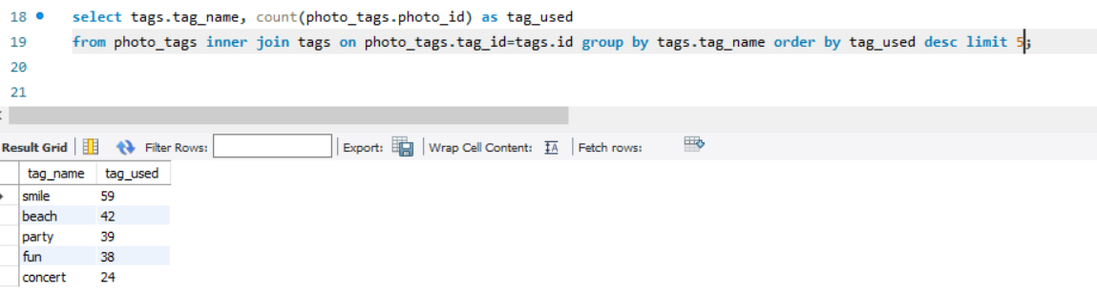
Q4. Identify and suggest the top five most commonly used hashtags on the platform.

Slide 10
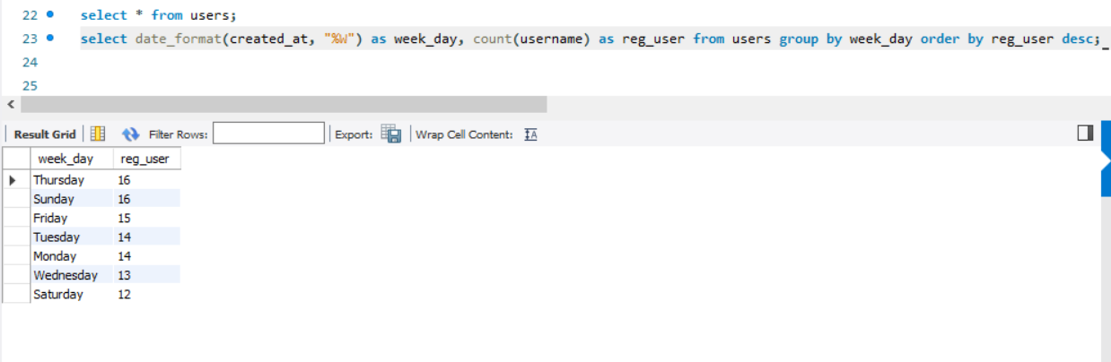
Q5. Determining the day of the week when most users register on Instagram. Provide insights on when to schedule an ad campaign.

Slide 11
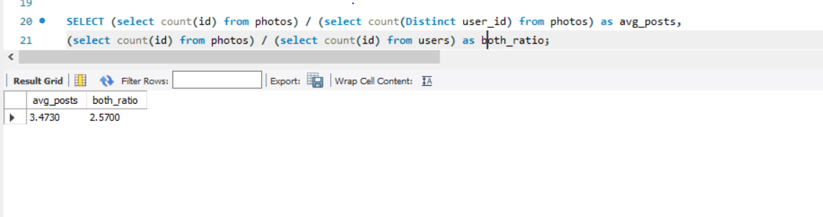
Q1. Calculating the average number of posts per user on Instagram. Also, provided the total number of photos on Instagram divided by the total number of users.
INSIGHTS: INVESTOR METRICS

Slide 12
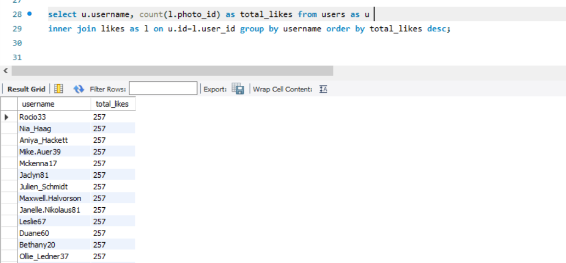
Q2. Identifying users (potential bots) who have liked every single photo on the site, as this is not typically possible for a normal user.

Slide 13
Results
This project help in learning the fundamentals of SQL queries and also helped in analyzing the data from a business point of view where marketing team can reward their old users. On top of that, they can encourage their inactive users by sending promotional emails, finding most active day for brand promotions and also organize contest for their users which can help the product manager and the rest of the team make informed decisions about the future direction of the Instagram app. By identifying the fake accounts from the platform can enhance the user experience and more user engagement can bring more profits to the company.

Slide 14
THANK YOU!

